Slide 1
Today’s Readings
Did the paper answer the research question?
Was the data appropriate for answering that question?
Was the method appropriate for answering that question?
Are the conclusions arrived at by the author supported by `their evidence?

Slide 2
Tokenization and Word Frequency
Prof. Sebastián Vallejo Vera

Slide 3
Glossary
Token = Word
Document = Collection of Tokens
Corpus = Collection of Documents

Slide 4
When doing quantitative text analysis, we assume:
That texts represent an observable implication of some underlying characteristic of interest (an attribute of the author, the subject, ...)
That texts can be represented through extracting their features--e.g., words--, or evaluating how these features interact in context—e.g., convolutional neural networks.
That we can analyze the frequency of features (as a document-feature matrix) with quantitative methods to measure these underlying characteristics, or we can analyze the interaction of these features to predict characteristics of the text.

Slide 5
There are two big approaches to computational text analysis:
Bag-of-words
Word embeddings

Slide 6
There are two big approaches to computational text analysis:
Bag-of-words
Word embeddings

Slide 7
Bag of Words
When applying a Bag-of-Words (BOW) approach, we are not particularly interested in the order of each token, or how the meaning of each token changes in context, or how tokens related to each other.
Rather, we are interested in when these tokens occur, how often, and in conjunction with what other tokens.
Thus, we assume that the meaning already embedded in each word (by us, political beings) gives us interpretable context, and their frequency an observable implication.

Slide 8
Word-Frequency Analysis
(Counting words)

Slide 9
Four steps are required for this analysis:
Determining the unit of analysis
Tokenization
Counting words over space and/or time
Denominating by totals

Slide 10
1. The Unit of Analysis
When analyzing text, we need to determine the unit of analysis.
Let’s say you want to analyze a corpus of Constitutions. What should the unit of analysis be?
The whole constitution?
Each chapter?
Each subsection?
Each law/amendment?

Slide 11
Determining the unit of analysis can have practical reasons (i.e., influenced by the state of the text analyzed).
Beyond these reasons, the most important consideration is your research question.
Before embarking on a long and computer-intensive exploration of your data, take a moment to decide what is the best way to answer your research question.
What are the hypotheses you will be testing?
What behavior or phenomenon are you trying to model?
Note: It is better to decide on the optimal unit of analysis before you start your analysis. However, choosing the optimal unit of analysis often requires some trial and error, as well as some experience.

Slide 12
2. Tokenization
Tokenization:
”I’m stylish, Glock tucked, big t-shirt, Billie Eilish, watch on my wrist, but I want that in diamonds.”
“I”, “’”, “m”, ”stylish”, “,”, ”Glock”, “tucked”, “,”, ”big”, “t”, ”-”, “shirt”, “Billie”, “Eilish”, “,”, “watch”, “on”, “my”, “wrist”, “,”, ”but”, ”I”, “want”, ”that”, “in”, “diamonds”, “.”

Slide 13
According to Grimmer et al. (2022), in addition to tokenization we need to:
Reduce complexity
Lowercase
Remove punctuation
Remove stop words
Create equivalence classes
Filter by frequency
Create a document-feature matrix (dfm).

Slide 14
According to Grimmer et al. (2022), in addition to tokenization we need:
Reduce complexity (think about this as reducing noise)
Lowercase
Remove punctuation
Remove stop words
Create equivalence classes
Filter by frequency
Create a document-feature matrix (dfm).

Slide 15
For the computer, Boat != boat. For humans, Boat = boat. Thus, we first turn all the words to lowercase:
“i”, “’”, “m”, ”stylish”, “,”, ”glock”, “tucked”, “,”, ”big”, “t”, ”-”, “shirt”, “billie”, “eilish”, “,”, “watch”, “on”, “my”, “wrist”, “,”, ”but”, ”i”, “want”, ”that”, “in”, “diamonds”, “.”

Slide 16
Since we are not analyzing tokens in context, we remove punctuation:
“i”, “m”, ”stylish”, ”glock”, “tucked”, ”big”, “t”, “shirt”, “billie”, “eilish”, “watch”, “on”, “my”, “wrist”, ”but”, ”i”, “want”, ”that”, “in”, “diamonds”

Slide 17
Stop words are common words used across documents that (most of the time) do not give much information about the task at hand.
In English, words like ”and”, “the”, and “a” may be removed from the documents to reduce the size and complexity of the feature set.
“m”, ”stylish”, ”glock”, “tucked”, ”big”, “t”, “shirt”, “billie”, “eilish”, “watch”, “wrist”, “diamonds”

Slide 18
For computers, cars != car. For humans, cars = car. For computers, read != reads != reading. For humans, read = reads = reading. Thus, to maintain the root of a word, we can stem. It might look something like this:
“m”, ”style”, ”glock”, “tuck”, ”big”, “t”, “shirt”, “billie”, “eilish”, “watch”, “wrist”, “diamond”

Slide 19
Finally, there are some tokens that either occur too much or occur too little for them to be relevant to the analysis yet can affect future modelling.
For example, in a corpus of Canadian laws, the tokens ”canada” and “law” will probably be quite common and quite uninformative.
Likewise, tokens that only appear once (or not often) in large corpora are unlikely to be useful.

Slide 20
According to Grimmer et al. (2022), in addition to tokenization we need:
Reduce complexity
Lowercase
Remove punctuation
Remove stop words
Create equivalence classes
Filter by frequency
Create a document-feature matrix (dfm).

Slide 21
A document-frequency matrix is an N-document x J-features.
Text 1: “m”, ”style”, ”glock”, “tuck”, ”big”, “t”, “shirt”, “billie”, “eilish”, “watch”, “wrist”, “diamond”
Text 2: “m”, ”type”, ”turn”, “detective”, ”got”, “phone”, “barely”, “check”, “em”
 | Features
Documents | m | style | glock | tuck | big | t | shirt | billie | …
Text 1 | 1 | 1 | 1 | 1 | 1 | 1 | 1 | 1 | …
Text 2 | 1 | 0 | 0 | 0 | 0 | 0 | 0 | 0 | …

Slide 22
Done… in the code we will talk about n-grams.

Slide 23
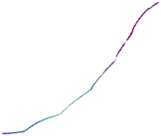
3. Counting Words Over Space/Time
Imagine a corpus of weekly class evaluations. Each document is an individual evaluation. We can count words over time:
Count all words for each time unit t (e.g., week)
Count all words denoting a word of interest (e.g., “amazing”)
Amazing Frequency
Week

Slide 24
4. Denominating by Total
Too good to be true… How can our inference go wrong?
That’s right: We do not know how many words were written in total.
What to do then?
Right again: We can use the proportion of ”amazing” to the total number of words written (adding a denominator).

Slide 25
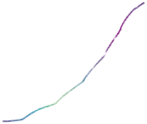
Total tokens
Prop. Of Amazing
Week
Week

Slide 26


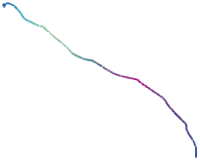
Total tokens
Prop. Of Amazing
Week
Week

Slide 27
Why Should We Care?

Slide 28
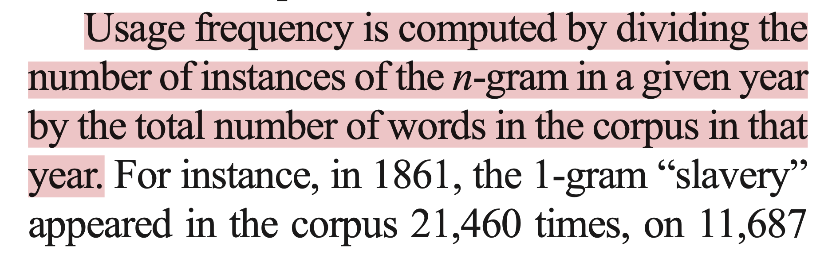
In Michel et al. (2011):

Slide 29
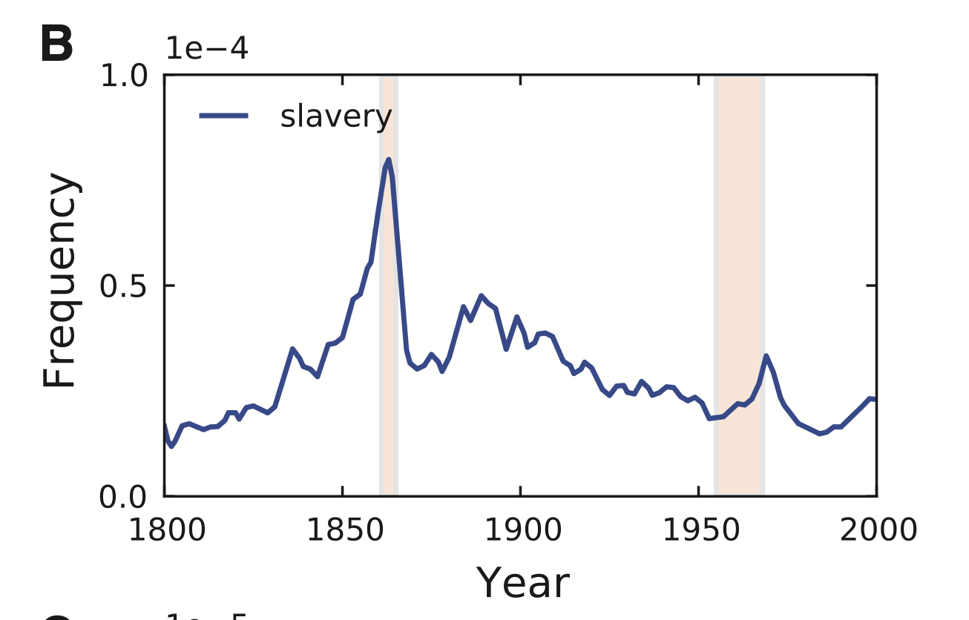

Slide 30
Some Methodological Considerations
What is the data generating process?
How was the original text sampled? What are the sources?
Is language use constant?
Can a single word capture a concept?
To what population can we make inferences about?
Other considerations?

